Slide 1
Spot the…
air pollution and solutions

Slide 2
What causes air pollution?

Slide 3
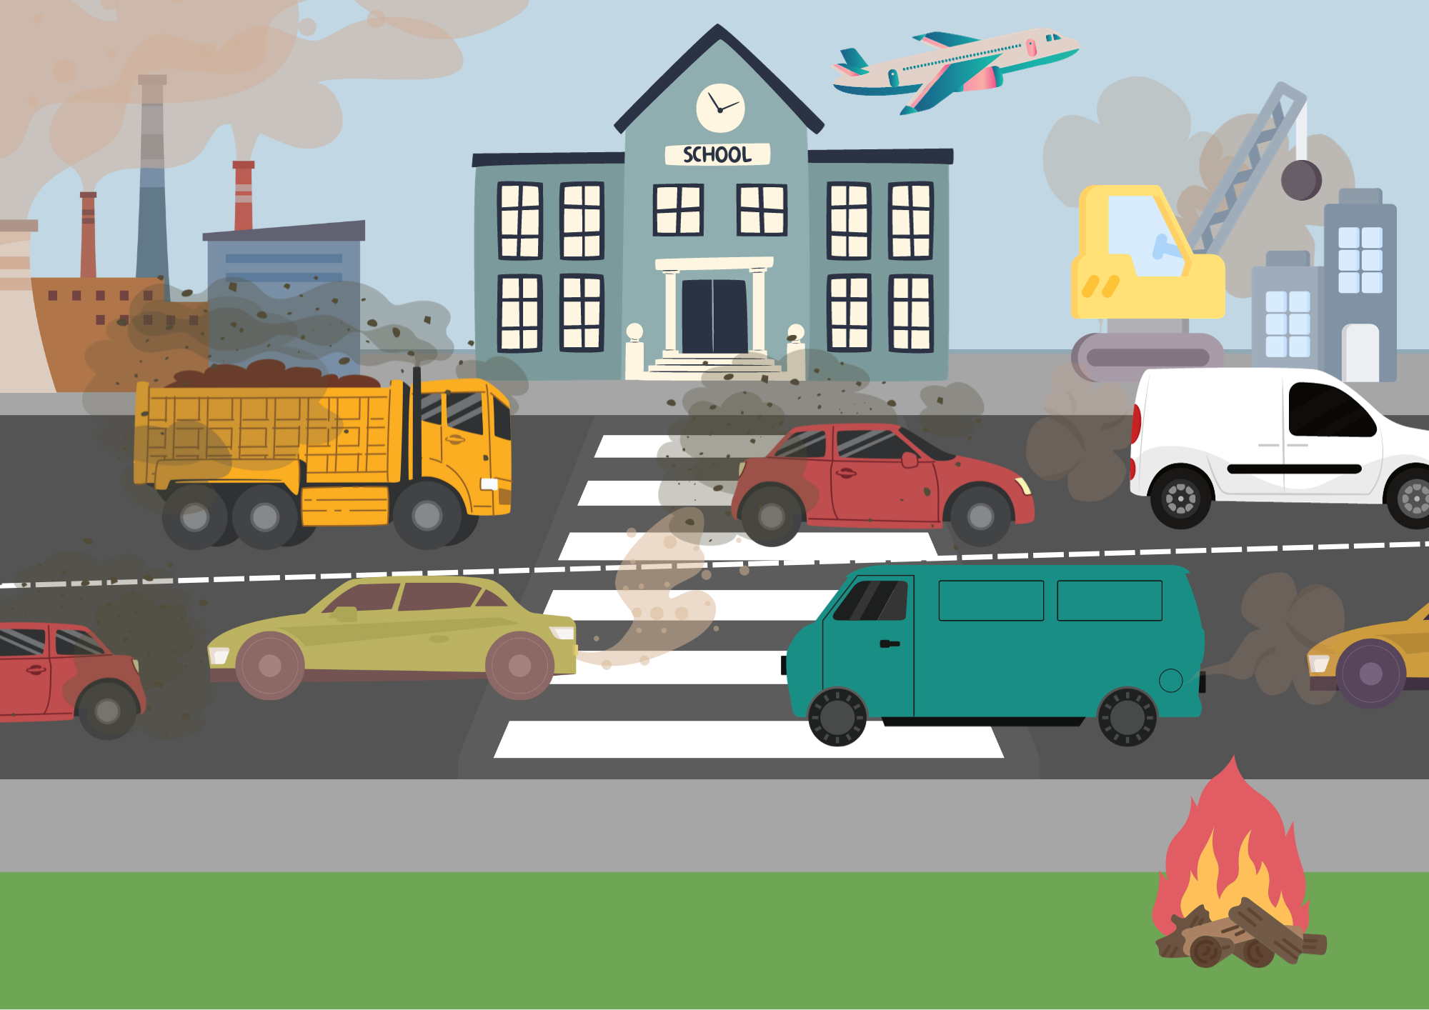
Can you find all the different causes of air pollution?
Notes:
Answers:
Factories
Construction/demolition
Aeroplanes
Road vehicles
Forest fires

Slide 4
What can we do to help reduce air pollution?
Notes:
What can we do to reduce air pollution and idling?

Slide 5
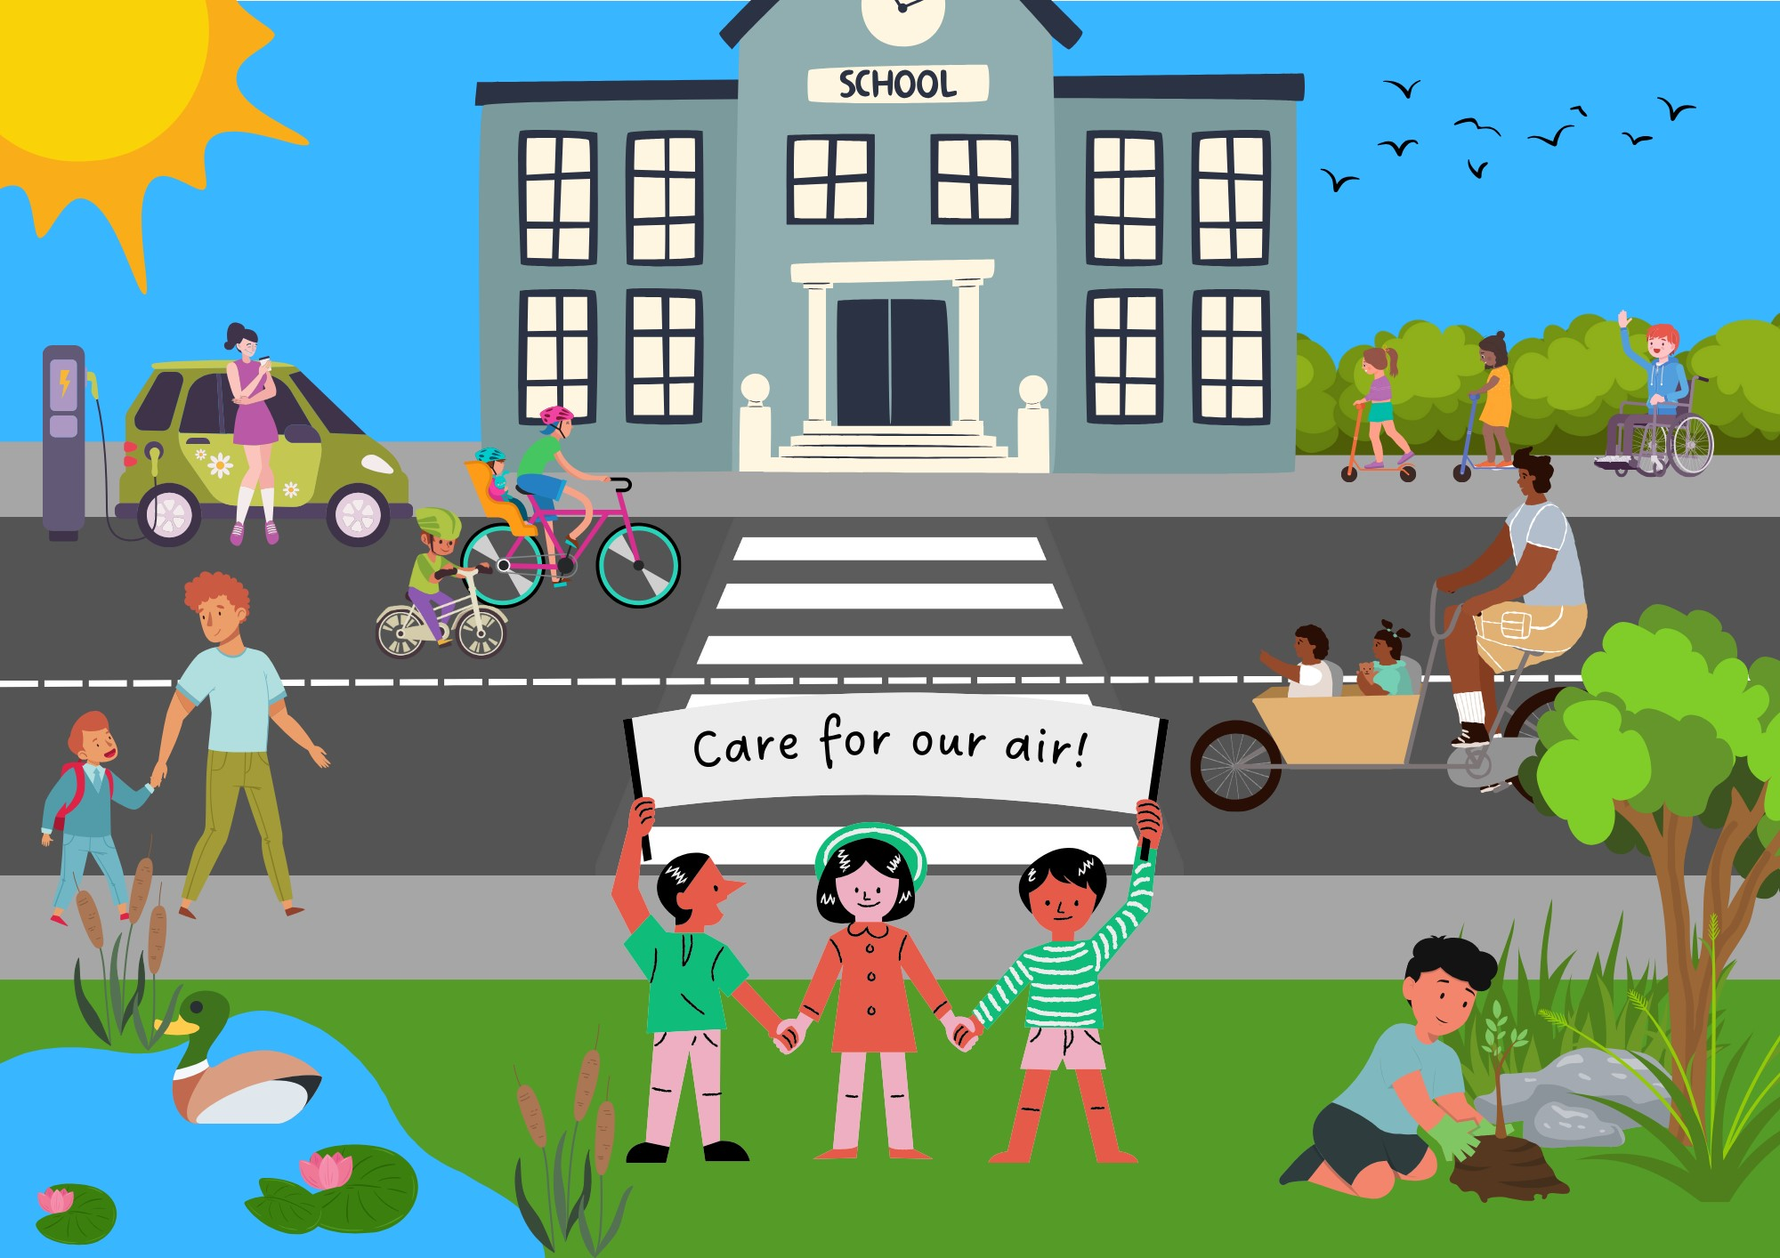
Can you find all the different ways we can clean up our air?
Notes:
Answers:
- park and stride
- walk to school
- cycle to school
- share lifts to school
- raise awareness
- turn engines off while parked or waiting
- walk quieter routes
- plant hedges
- use electric cars

